Slide 1
Starburst

Slide 2
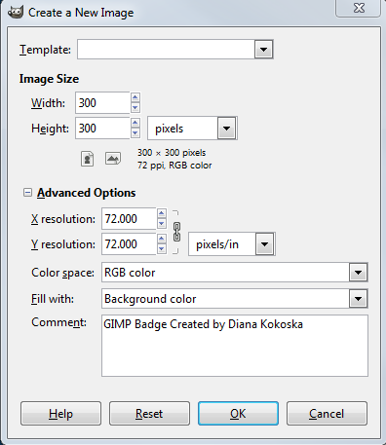
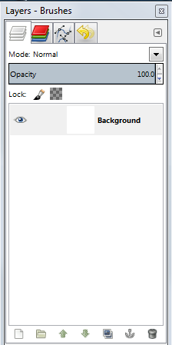
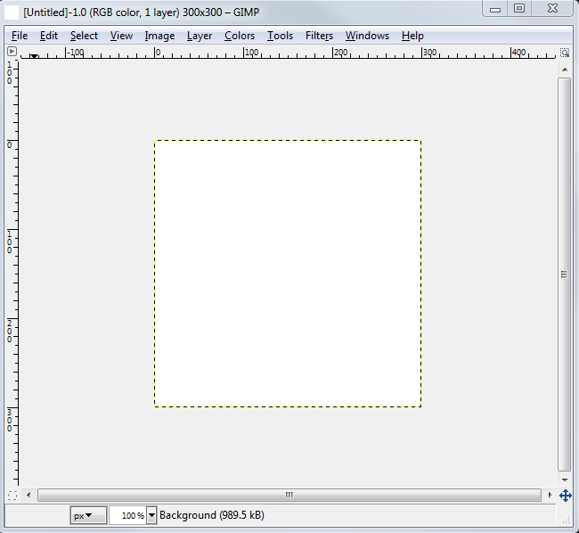
GIMP® is all about IT (Images and Text)
OPEN GIMP®
Step 1: To begin a new GIMP® project, from the Menu Bar, select File | New. At the Create a New Image dialog box, select a size and background color for your new image.
I selected 300 x 300 pixels with a white background, but you can select any size with an equal width and height.
You will need to click the + sign beside Advanced Options to expand the menu. In the Comment text box, describe the image. Click the OK button.
A new image canvas displays in the GIMP® workspace with image information in the Title Bar and a “Background” layer displays in the Layers palette to the right of the image window.

Slide 3
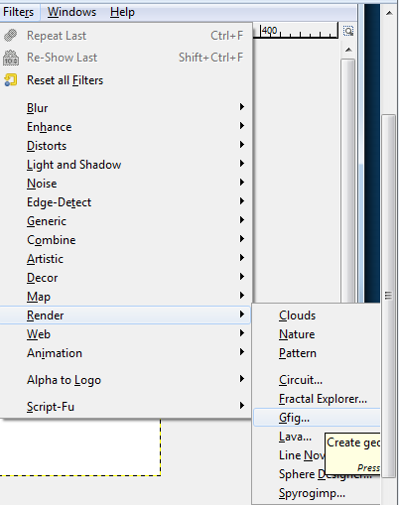
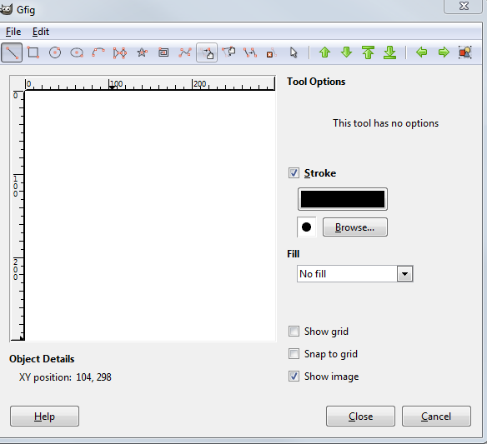
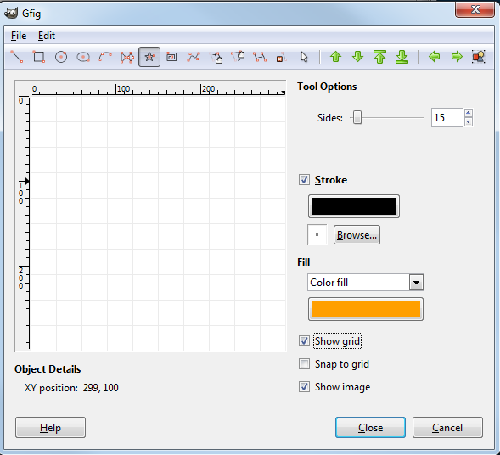
From the Menu Bar, select Filters | Render | Gfig… At the gFig dialog box, click the Create star shape in Tools
You will need to adjust several of the tool options:
Change the Sides to the number of points you want on your starburst. (15)
Under Stroke, you can change the color of the star outline (I left mine at Black). Click the Browse… button in the Stroke options and select the smallest brush size (Circle 01 3x3)
Click the Fill down arrow and select Color fill and click the color icon below it to select the fill color. I selected a bright orange HTML notation: ff9f00
Select the Show grid option DO NOT CLICK CLOSE!

Slide 4
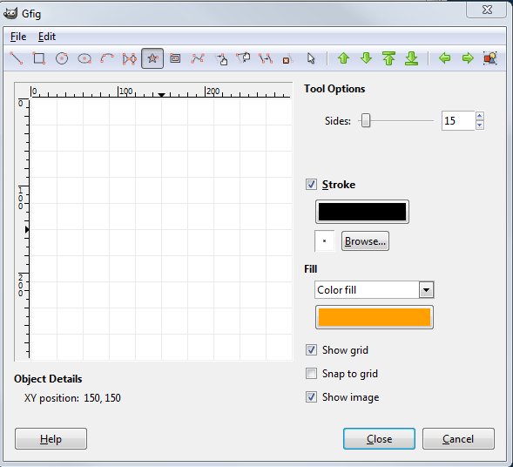
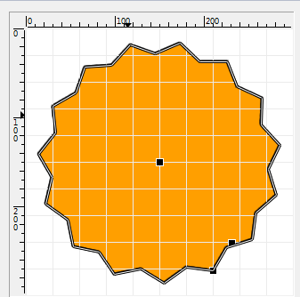
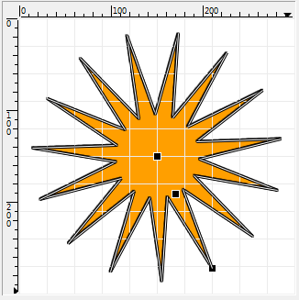
Click in the Center of the Grid – XY position of 150px
In the Menu Bar, click the “Move a single point icon”
Click on the Center square point and drag out until you have a star burst with less depth
+
Drag out and down from the center until you have a star shape that is does not quite touch the edges of the canvas.
Click the gFig Close button.

Slide 5
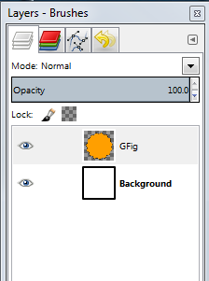
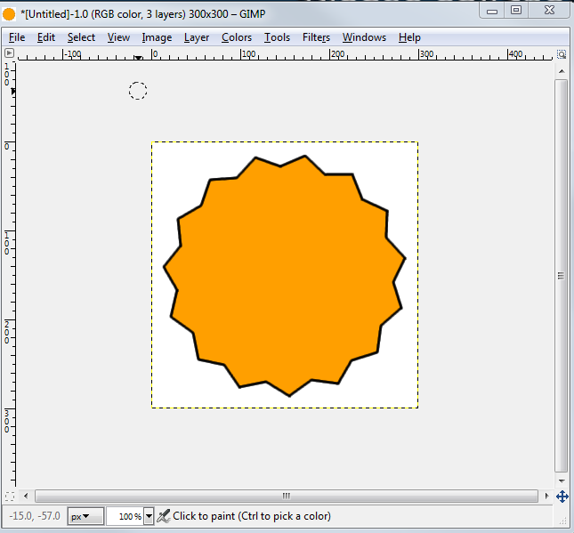
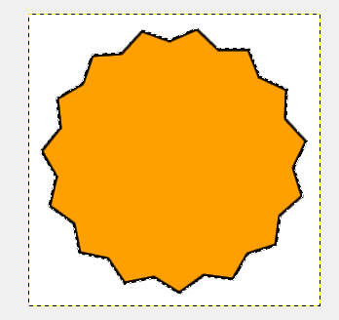
This looks like a great start! Who knew it could be this easy?
You may need to click the Layers icon to display the Layers Palette
A new GFig layer displays above the background Layer.
Select the new GFig layer in the Layers Palette. Right click on the GFig layer and select Alpha to Selection to select the current shape.
As an alternative, you can hold down the Alt Key and click the GFig layer.
Marching ants display around the starburst shape

Slide 6
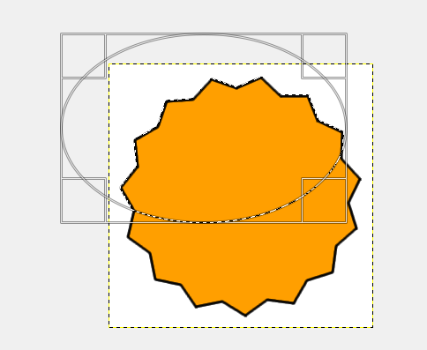
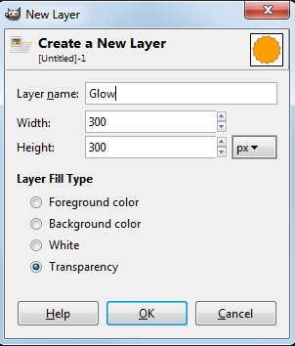
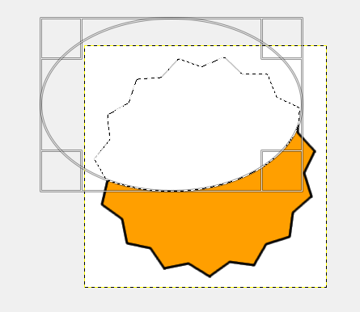
Click the Create a New Layer and Add it to image icon in the Layers palette, name the new layer Glow.
A new Layer named Glow displays above the Gfig layer in the Layers palette.
Draw an ellipse on the top half of the starburst. You may want to start outside the canvas.
In the Ellipse Tool options, change the mode to Intersect with current selection.
VERY IMPORTANT –if you miss this step the circle will sit on top of the starburst and go outside the image.
From the Menu Bar, select Edit, Fill with background color. (your background color should be white)

Slide 7
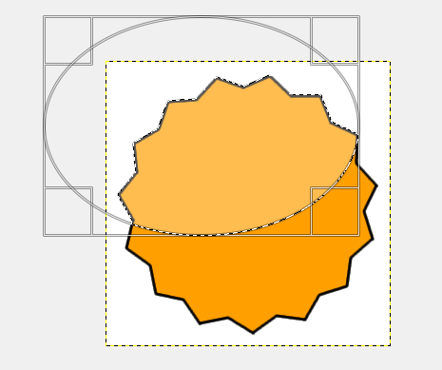
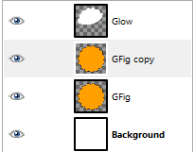
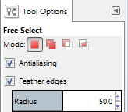
With the GFig Layer selected and the marching ants around the only the top half of the starburst, change the Opacity Level in the Layers palette to approximately 30%. This will give you the two shades of similar colors. Press Select | None or Ctrl+Shift+A to remove the marching ants
Right click the GFig layer in the Layers palette and select Duplicate Layer. A new Gfig copy layer displays above the GFig layer in the Layers palette.
Click the Gfig copy layer and click the Free Select Tool in the Toolbox.
In the Free Select tool options, select Feather Edges and select a radius of about 50. This will make the glow lighter on the edges.
Very nice! Now let’s add a glow to the bottom of the star!

Slide 8
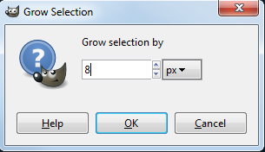
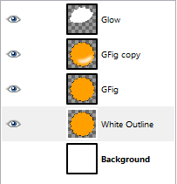
Now draw a freehand half circle in the bottom half of the Starburst and select Edit | Fill with background color.
Adjust the Opacity Level in the Layers palette to lighten the glow. I selected about 60% to give a light glow. Click Select | None to remove the marching ants.
Now let’s add a white outline and a black outline outside the starburst. But before we do that, let’s click the visibility icon beside the background layer in the Layers palette to make the background transparent.
Right click the CFig layer in the Layers Palette and select Duplicate Layer. A new layer named GF copy#1 displays above the Gfig Layer. Drag the layer below the Gfig layer (above the Background layer). Double click the Name of the new layer and name it White Outline.
Right click the White Outline layer in the Layers palette and select Alpha to Selection to display marching ants around the starburst.
Click Select | Grow.. and enter 8 px and click the OK button.
The marching ants move 8 pixels outside the starburst.

Slide 9
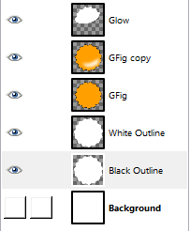
From the Menu Bar, select Edit | Fill with background color.
Right click the White Outline layer in the Layers palette and select Duplicate Layer. A new layer named White Outline copy displays above the White Outline layer. Drag it below the White Outline layer and double click the name and type “Black Outline.”
Right click on the Black Outline layer and select Alpha to Selection.
With the Black Outline Layer selected in the Layers palette, click Select | Grow and type 3px and click OK.
The marching ants move out 3 pixels from the white outline. Click Edit | Fill with foreground color.
Press Ctrl+Shift+A or click Select | None to remove the marching ants.

Slide 10
Now all you need to do is add some text!

